Slide 1
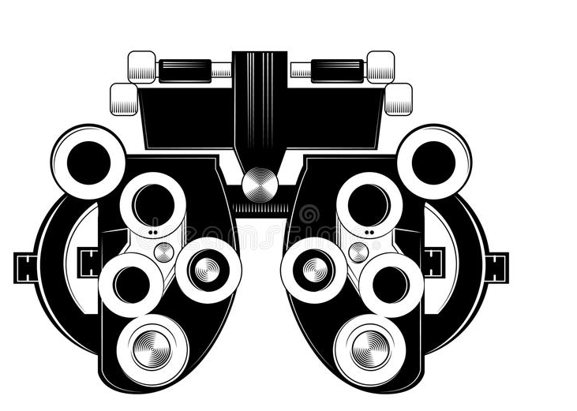
Determining astigmatism axis What is astigmatism?
1.4 million Australians have astigmatism. Astigmatism is comprised of both an axis (direction) and power (magnitude). Astigmatism occurs when the front surface of the eye, the cornea, has an asymmetric curvature. Normally the cornea is equally curved in all directions, and light entering the cornea is focused equally on all planes, or in all directions (think of an orange). In astigmatism, the front surface of the cornea is curved more in one direction than in another (like a lemon).

Slide 2
Cylinder is used to correct astigmatism
Cylinder is used to correct astigmatism, meaning one meridian has no added curvature, and the meridian perpendicular to this “no added power” meridian contains the maximum power and lens curvature to correct astigmatism. Cylinder power is always preceded with a negative (minus) sign. Cylinder power always follows sphere power. Meridians of the eye are determined by superimposing a protractor scale on the eye’s front surface. This is the astigmatism axis (cylinder axis). The 90-degree meridian is the vertical meridian of the eye, and the 180-degree meridian is the horizontal meridians.

Slide 3
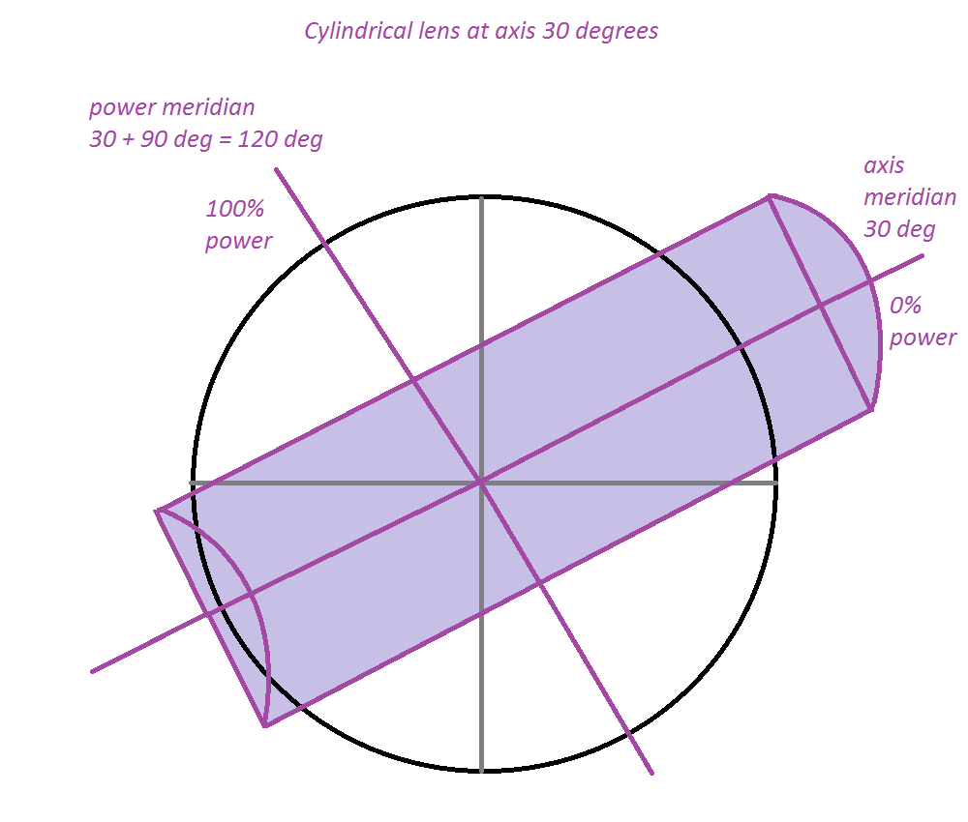
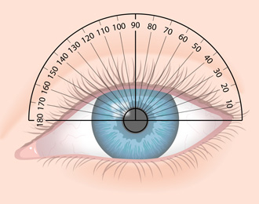
Astigmatism axis
Left image: The axis for cylinder is determined by superimposing a protractor scale on the eye’s front surface.
Right image: The axis for cylinder runs along it’s longest meridian. In this example, the axis of the cylinder is 30 degrees. The power of the cylinder runs at 90 degrees to the axis, along the shortest meridian of the cylinder. In this example, the power runs along 120 degrees. Cylinder axis and power are always at 90 degrees (perpendicular) to each other.

Slide 4
Example of a prescription
Note cylinder power is always minus and in 0.25D steps
Note axis is always a value 1 to 180 (Cannot be zero)
In measuring a prescriptions, astigmatism axis is determined, then power.

Slide 5
Astigmatism
There are 3 main types of regular astigmatism, classed based on the axis of the principal meridian:
With the rule astigmatism (WTR): the vertical meridian is the steepest (written as x180 on prescription)
Against the rule astigmatism (ATR): the horizontal meridian is the steepest (written as x90)
Oblique astigmatism: the steepest meridian lies between 120-150 and 30-60 degrees
Majority of people have some degree of astigmatism. WTR and ATR are the most common, oblique is less common.

Slide 6
Before we begin:
The following outline assumes the user is always selecting what is true for themselves, not accidently clicking the wrong button (left, right or same) or giving wry answers.
The end point (final axis) is considered to be when the user cannot tell which grating is clearer; they appear equally blurry.
Initially, I believe it is realistic this test initially operates in 5° increments of presentation for the orientation of the gratings. So gratings should be able to be presented at 5°, 10°, 15°, 20° ….. 170°, 175°, 180° meaning there are 36 potential orientations (Note: 0° is not an axis, it is rather called 180°).

Slide 7
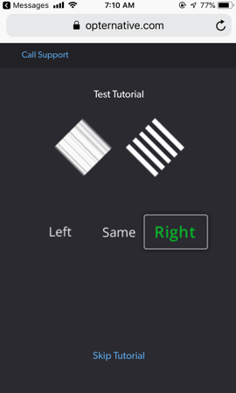
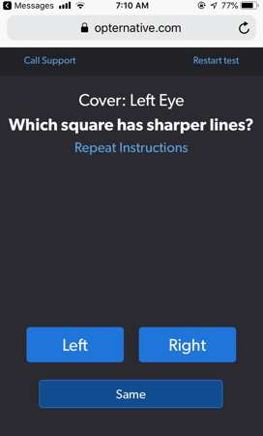
What we’re going to do
Two grated targets are presented to the user. The patient selects which of the two gratings are clearer (left or right), or if they appear equally blurry. This mirrors how an Optometrist checks for astigmatism using a Jackson Cross Cylinder. The end point is when the two gratings appear equally blurry.

Slide 8
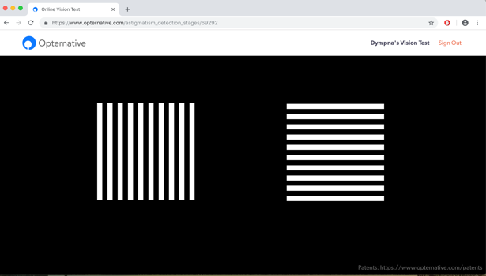
First presentation
The first presentation should always be with the gratings horizontal and vertical. This is because the most common cylinder axis within the population are with-the-rule (axis 180) and against-the-rule (axis 90).
Left grating running along 90 degrees. Right grating running along 180 degrees.
The user selects which grating is clearest, left, right or same. A user with cylinder axis 180 degree astigmatism will see the left grating clearest, while a user with axis 90 degree astigmatism will see the right grating clearest.
What next?
Option 1: User selects both gratings appear equally clear.
Option 2: User selects left grating appears clearest. This indicates user has axis 180° astigmatism or close to that
Option 3: User selects right grating appears clearest. This indicates user has axis 90° astigmatism or close to that

Slide 9
Option 1: User selects both gratings appear equally clear
This indicates one of three things:
User has no, or a very small amount, of astigmatism
User has axis 45° astigmatism, or close to that
User has axis 135° astigmatism, or close to that
So, now we need to determine if it’s 1), 2) or 3). We do this by rotating the bars in 45° steps to check about axis 90/180, so the gratings are presented at 45/135.

Slide 10
Checking axis 180/90
The next presentation of the gratings should be along axis 45 (left image) and 135 (right image). This is a 45 degree rotation.
If the user selects:
Left grating clearest: Indicates user has astigmatism axis 135° or close to that
Right grating clearest: Indicates user has astigmatism axis 45° or close to that
Equally clear: Indicates user has no astigmatism

Slide 11
Equally clear: Indicates user has no astigmatism
The user selected has selected that both gratings are equally clear. This indicates there is no astigmatism. To double check and ensure that there is no astigmatism we need to “fish for cylinder”. We have already checked axis 90/180 and 135/45. Given the most common axis for astigmatism are 90 ± 20° and 180 ± 20°, I think we should try axis 80/170 and 10/100.

Slide 12
So the next presentation is axis 80 (left image) and 170 (right image):
If the user indicates both are equally clear, then axis 100 (left image) and 10 (right image) are checked:
If the user indicates that both options are equally clear this can be considered the end point, the user has no (or certainly only a very small amount) of astigmatism. Done!

Slide 13
Option 2: User selects left grating appears clearest
This indicates the user has astigmatism axis 135° or close to that.
The next presentation should be checking for axis 135°. To check for axis 135° we have to present the gratings at 45 degrees either side of 135°, so 90/180, which as you may recall we did with the first presentation.
So now, we try bracketing 10° either side of 135° (so axis 125 and axis 145). Bracketing is confirming responses either side of a suspected axis. This process of bracketing will be the same for any final suspected cylinder axis.
It is arbitrary if axis 125 or 145 is checked first. Let’s present axis 125 first. 45 degrees either side of 125 ° is 80/170. It doesn’t matter which grating is on the left vs right.
At this stage, let’s create a specific example we are working towards for the user. Let’s say the user has astigmatism x135 (axis 135). All responses from now will be with based on getting towards this answer.

Slide 14
Example - Finding axis 135
Checking axis 125
Left image: Grating running along 80 deg. Right image: Grating running along 170 deg.
If the user selects:
Left grating clearest: Indicates user has axis 170° astigmatism or close to that. We are expecting the user to select this, as 170° is 35° off axis 135 (final cyl axis). So we know we need to move from axis 125 back to axis 135.
Right grating clearest: Indicates user has axis 80° astigmatism or close to that. We are not expecting the user to select this, as 170° is 55° off axis 135. This would indicate the user wants to move from axis 125 towards axis 80° (chasing the cylinder).
Equally clear: Indicates user has axis 125° astigmatism.

Slide 15
Bracketing for axis 135
So now that we have successfully bracketed at 125° and been re-directed towards 135°, let’s try bracketing 10° to the other side of our suspected cyl axis 135° which is axis 145°. 45° to either side of 145 is 10/100.

Slide 16
Checking axis 145
Left image: Grating running along axis 100. Right image: Grating running along axis 10.
If the user selects:
Left grating clearest: Indicates user has axis 10° astigmatism or close to that. We are not expecting the user to select this, as 10° is 35° off axis 135 (final cyl axis). So we know we need to move from axis 145 back to axis 135.
Right grating clearest: Indicates user has axis 100° astigmatism, or close to that. We are expecting the user to select this, as 100° is 55° off axis 135. This means the user wants to move from axis 145 back towards axis 135°.
Equally clear: Indicates user has axis 145° astigmatism.

Slide 17
Bracketing for axis 135
So now we have successfully bracketed 10° either side of 135, we have confirmed our cylinder axis as 135° - done. This is our endpoint!

Slide 18
Another example – axis 150
Let’s work through another cylinder axis example
Let’s pretend the user has astigmatism axis 150.

Slide 19
First presentation – finding axis 150
The first presentation should always be with the gratings horizontal and vertical. This is because the most common cylinder axis within the population are with-the-rule (axis 180) and against-the-rule (axis 90).
Left grating running along 90 degrees. Right grating running along 180 degrees.
If the user selects:
Left grating clearest: Indicates user has axis 180 astigmatism or close to that. We are expecting the user to select this, as 180° is 30° off axis 150 (final cyl axis).
Right grating clearest: Indicates user has axis 90° astigmatism, or close to that. We are not expecting the user to select this, as 90° is 60° off axis 150 Is this correct?
Equally clear: Indicates user has axis 35/145/no astigmatism.

Slide 20
Point of uncertainty
For a user with cyl axis 150, would they select the grating running along 90 clearest?
Alternatively, could they perceive both gratings to be (relatively) equally clear? The midpoint between the gratings at 90/180 is 45/135. 135 is 15° from 150 – so potentially could this be the answer and the gratings appear equally clear?
If so, what is the range of preference for a grating based on the users astigmatism? Could it be their axis of astigmatism ± 20° either side?
I am going to ‘go with my best hunch’ that a user with axis 150 would perceive the left grating (running along 90) as clearest.

Slide 21
Finding axis 150
User has selected left grating appears clearest, indicating axis 180° astigmatism or there-about.
We now want to check axis 180. We do so by presenting the gratings 45° either side of 180 at 45/135.

Slide 22
Checking axis 180
Left grating: Running along 45. Right grating: Running along 135.
If the user selects:
Left grating clearest: Indicates user has axis 135° astigmatism or there about. We are expecting the user to select this, as 135° is 15° off their axis 150. So we now need to move from axis 180 towards 135. From now we move in 10° steps.
Right grating clearest: Indicates user has axis 45° astigmatism or there about. We are not expecting the user to select this, as 45° is 75° off axis their axis 150.This would the user wants to move from axis 180 towards axis 45°.
Equally clear: Indicates user has axis 180° astigmatism.
Left grating clearest: So now, we move in a 10° step from axis 180 to axis 170. The gratings are presented 35/125.

Slide 23
Checking axis 170
Left grating: Running along 35. Right grating: Running along 125.
If the user selects:
Left grating clearest: Indicates user has axis 125° astigmatism or there about. We are expecting the user to select this, as 125° is 25° off their axis 150. So we know we need to move from axis 170 towards 125.
Right grating clearest: Indicates user has axis 35° astigmatism or there about. We are not expecting the user to select this, as 35° is 65° off axis their axis 150. This would the user wants to move from axis 170 towards axis 35°.
Equally clear: Indicates user has axis 170° astigmatism.
Left grating clearest: So now, we move in a 10° step from axis 170 to axis 160. The gratings are presented 25/115.

Slide 24
Checking axis 160
Left grating: Running along 25. Right grating: Running along 115.
If the user selects:
Left grating clearest: Indicates user has axis 115° astigmatism or there about. We are expecting the user to select this, as 115° is 35° off their axis 150. So we know we need to move from axis 160 towards 115.
Right grating clearest: Indicates user has axis 25° astigmatism or there about. We are not expecting the user to select this, as 25° is 55° off axis their axis 150. This would the user wants to move from axis 160 towards axis 25°.
Equally clear: Indicates user has axis 160° astigmatism.
Left grating clearest: So now, we move in a 10° step from axis 160 to axis 150. The gratings are presented 15/105.

Slide 25
Checking axis 150
Left grating: Running along 15. Right grating: Running along 105.
If the user selects:
Left grating clearest: Indicates user has axis 105° astigmatism or there about. We are not expecting the user to select this, as 105° is 55° off their axis 150, which is their mid-point.
Right grating clearest: Indicates user has axis 15° astigmatism or there about. We are not expecting the user to select this, as 15° is 45° off axis their axis 150, which is their mid-point.
Equally clear: Indicates user has axis 150° astigmatism. We are expecting the user to select this option.
We have reached the point of equivalence! Now we have to bracket 10° either side of 150. We have already done 160, so now let’s try 140 to determine if our suspected axis of 150 is confirmed. For axis 140, gratings at 5/95 are presented.

Slide 26
Checking axis 140
Left grating: Running along 5. Right grating: Running along 95.
If the user selects:
Left grating clearest: Indicates user has axis 95° astigmatism or there about. We are not expecting the user to select this, as 95° is 55° off their axis 150. This would the user wants to move from axis 140 towards axis 95°. So we know we need to move from axis 140 towards 15.
Right grating clearest: Indicates user has axis 5° astigmatism or there about. We are expecting the user to select this, as 5° is 35° off axis their axis 150. This would the user wants to move from axis 140 back towards taxis 150°.
Equally clear: Indicates user has axis 140° astigmatism.
So now we have successfully bracketed 10° either side of 150, we have confirmed our cylinder axis as 150° - done.

Slide 27
Finding axis 150
We have successfully bracketed 10° either side of 150, we have confirmed our cylinder axis as 150° - done. This is our endpoint!

Slide 28
Another example – axis 180
Let’s work through another cylinder axis example
Let’s pretend the user has astigmatism axis 180.

Slide 29
First presentation – finding axis 180
The first presentation should always be with the gratings horizontal and vertical. This is because the most common cylinder axis within the population are with-the-rule (axis 180) and against-the-rule (axis 90).
Left grating running along 90 degrees. Right grating running along 180 degrees.
If the user selects:
Left grating clearest: Indicates user has axis 180 astigmatism or close to that. We are expecting the user to select this, as 180° is our endpoint.
Right grating clearest: Indicates user has axis 90° astigmatism, or close to that. We are not expecting the user to select this, as 90° is 90° off the users axis 180.
Equally clear: Indicates user has axis 35/145/no astigmatism.
User has selected left grating appears clearest, indicating axis 180° astigmatism or there-about. As aforementioned, axis 180±20° (with-the-rule astigmatism) is very common, especially in people <50yo. As before, when an axis is suspected the gratings must be presented at 45° to the suspected axis, so at 45° and 135°.

Slide 30
Checking axis 180
Left grating: Running along 45. Right grating: Running along 135.
If the user selects:
Left grating clearest: Indicates axis 135° or close to that. As a side note, if the user had axis 175, 170, 165, 160 ect they would select this option is clearer.
Right grating clearest: Indicates axis 45° degrees or close to that. As a side note, if the user had axis 5, 10, 15, 20 ect they would select this option is clearer.
Equally clear: Indicates 180° astigmatism. In our example when the user has axis 180° astigmatism we expect them to select this option. HOWEVER, this is different to fishing for cylinder here as the previous answer that fed/resulted in this position was option 1 here, where both gratings appeared equal. This time, we have already selected that the gratings running along 90 appear clearer (previous slide)
The user has selected equally clear, so we must bracket 10° either side of 180° (180± 10°) so 170° and 10°. It is arbitrary which is checked first. Let’s check 10°, so the gratings must be presented 45° either side at 55/145.

Slide 31
Checking axis 10
Left grating: Running along 55 degrees. Right grating: Running along 145
If the user selects:
Left grating clearest: Indicates axis 55° or close to that. We are NOT expecting this user to select this option as 55° is 55° off 180°.
Right grating clearest: Indicates axis 145° degrees or close to that. We are expecting the user to select this option as 145° is 35° off 180°.
Equally clear: Indicates 10° astigmatism.
User has selected the right grating is clearest, confirming our suspicions the axis is 180°. Now, let’s bracket on the other side, so axis 170; the gratings must be presented 45° either side at 35/125

Slide 32
Checking axis 170
Left grating: Running along 35 degrees. Right grating: Running along 125.
If the user selects:
Left grating clearest: Indicates axis 125° or close to that. We are NOT expecting this user to select this option as 125° is 55° off 180°.
Right grating clearest: Indicates axis 35° degrees or close to that. We are expecting the user to select this option as 35° is 35° off 180°.
Equally clear: Indicates 170° astigmatism.
So the user has selected the right grating is clearest, confirming our suspicions the axis is 180°. We have successfully bracketed 180±10° (so 10° and 170°) and had 180° confirmed here, we are finished, our end point has be achieved and confirmed.

Slide 33
Finding axis 180
We have successfully bracketed 10° either side of 180, we have confirmed our cylinder axis as 180° - done. This is our endpoint!

Slide 34
Final example – axis 85
Let’s work through another cylinder axis example - let’s pretend the user has astigmatism axis 85.
In this example, 85° astigmatism brings added complexity as it lies mid-way between 80 and 90°. At this stage, for the sake of simplicity, we are only looking for cylinder in 10° increments. So what would happen when a user has astigmatism not exactly on our 10° increments? One of two things will happen, depending on the user:
An unreliable user, or a user with only a small amount of astigmatism, would find axis 80 and 90 to both be endpoints (equally blurry).
The user will fluctuate between axis 80 and axis 90.

Slide 35
First presentation – finding axis 85
The first presentation should always be with the gratings horizontal and vertical. This is because the most common cylinder axis within the population are with-the-rule (axis 180) and against-the-rule (axis 90).
Left grating running along 90 degrees. Right grating running along 180 degrees.
If the user selects:
Left grating clearest: Indicates user has axis 180 astigmatism or close to that. We are not expecting the user to select this, as 180° is 85° off our endpoint.
Right grating clearest: Indicates user has axis 90° astigmatism, or close to that. We are expecting the user to select this, as 90° is 5° off the users axis 85.
Equally clear: Indicates user has axis 35/145/no astigmatism.
User has selected right grating appears clearest, indicating axis 90° astigmatism or there-about. As aforementioned, axis 90±20° (against-the-rule astigmatism) is very common, especially in people >50yo. As before here, here and here, when an axis is suspected the gratings must be presented at 45° to the suspected axis, so at 45° and 135°.

Slide 36
Checking axis 90
Left grating: Running along 45. Right grating: Running along 135.
As aforementioned, one of two things will happen, depending on the user:
An unreliable user, or a user with only a small amount of astigmatism, would find axis 80 and 90 to both be endpoints (equally blurry).
The user will fluctuate between axis 80 and axis 90
So, if the user selects:
Left grating clearest: Indicates axis 135° or close to that. We are not expecting this option as the axis for the user in this example is 85°.
Right grating clearest: Indicates axis 45° degrees or close to that. We could get this option, which is number 2) above. This indicates the user has an axis more towards 45° so 85, 80, 75, 70 ect.
Equally clear: Indicates 90° astigmatism. We could also get this option, which is number 1) above.
Let’s work through if the user selected the right grating clearest first. We will work through the user selecting both gratings are equally clear later here.

Slide 37
Finding axis 85
Let’s work through if the user selected the right grating clearest first. We will work through the user selecting both gratings are equally clear later here.
The user has selected the right grating is the clearest, indicating axis 45° degrees or close to that. We could get this option, so which number 2) above. This indicates the user has an axis more towards 45° so 85, 80, 75, 70 ect.
So, we will work in a 10 degree step toward 45° to axis 80°. To check axis 80° the gratings must be presented at 45° to 80° so 35/125.

Slide 38
Checking axis 80
Left grating: Running along 35. Right grating: Running along 125.
If the user selects:
Left grating clearest: Indicates axis 125° or close to that. The user could select this option, as 125° is 40° off 85°. This tells us to go back to 90°.
Right grating clearest: Indicates axis 35° degrees or close to that. We are not expecting the user to select this option as 35° is 50° off 85°.
Equally clear: Indicates 80° astigmatism. Given that we just tried axis 90 and were directed to axis 80 here, we are not expecting the user to chose this option as it directs us more towards axis 80.
If the user selects the left grating is clearest, we have reached our endpoint. We tried axis 90 and were directed towards axis 80. We tried axis 80 and were directed to axis 90. We know the user has an axis between 80-90. Done.
Alternatively, the user could have selected equally clear. We are not expecting this option. In this instance, we tried axis 90 and were directed towards axis 80, now at axis 80 we have both gratings were found to be equally clear. This might indicate the axis in the range 78-82°.

Slide 39
Finding axis 85
Let’s go back to checking axis 90 with the gratings at 45/135 and pretend the user chose equally blurry.

Slide 40
Checking axis 90
Left grating: Running along 45. Right grating: Running along 135.
As aforementioned, one of two things will happen, depending on the user:
An unreliable user, or a user with only a small amount of astigmatism, would find axis 80 and 90 to both be endpoints (equally blurry).
The user will fluctuate between axis 80 and axis 90
So, if the user selects:
Left grating clearest: Indicates axis 135° or close to that. We are not expecting this option as the axis for the user in this example is 85°.
Right grating clearest: Indicates axis 45° degrees or close to that. We could get this option, which is number 2) above. This indicates the user has an axis more towards 45° so 85, 80, 75, 70 ect.
Equally clear: Indicates 90° astigmatism. We could also get this option, which is number 1) above.
Now, let’s work through the user selecting equally clear. We need to bracket 10° either side of 90 (90±10°) so axis 80 and axis 100. It is arbitrary which axis is assessed first, let’s do 100 first by presenting the gratings at 45° of 100, so 55/145.

Slide 41
Checking axis 100
Left grating: Running along 55. Right grating: Running along 145.
If the user selects:
Left grating clearest: Indicates axis 145° or close to that. We are not expecting the user to select this option, as 125° is 55° off 90°.
Right grating clearest: Indicates axis 55° degrees or close to that. We are expecting the user to select this option as 55° is 35° off 90°.
Equally clear: Indicates 100° astigmatism. We are not expecting this option.
So, the user has selected the right grating is clearest, telling us to go back to 90°. Now, let’s bracket by 10° to the other side of 90 at 80° by presenting bars at 35/125.

Slide 42
Checking axis 80
Left grating: Running along 35. Right grating: Running along 125.
If the user selects:
Left grating clearest: Indicates axis 125° or close to that. We are not expecting this option as this would tell us to go back to axis 90, making axis 90 our endpoint.
Right grating clearest: Indicates axis 35° degrees or close to that. We are not expecting this as this would tell us to go towards axis 70.
Equally clear: Indicates 80° astigmatism. We are expecting this option.
So now, we have been told axis 90 and axis 80 are both equally blurry, informing us the axis is between 80-90°. We have already bracketed to 100°, so let’s bracket to the other side at axis 70. To check axis 70 we have to present the gratings at 45° of 70, so 25/115.

Slide 43
Checking axis 70
Left grating: Running along 25. Right grating: Running along 115.
If the user selects:
Left grating clearest: Indicates axis 115° or close to that. We are expecting the user to select this option, as 115° is 35° off 80°.
Right grating clearest: Indicates axis 25° degrees or close to that. We are not expecting the user to select this option as 25° is 55° off 80°.
Equally clear: Indicates 70° astigmatism. We are not expecting this option.
So, the user has selected the right grating is clearest, telling us to go back to 80°. We have successfully bracketed at axis 100 and axis 70, and we were told by the user that both 90 degrees and 80 degrees were equally clear so we know the axis is between 80-90 degrees. Done.

Slide 44
In summary
Gratings always 90 degrees to each other
Follow user in direction of clearest grating
Endpoint is when user cannot tell the difference between two gratings
In searching for this endpoint might have to “move around” checking different meridians
When the point of equivalence is found, must confirm by bracketing in 10 degree increments either side of the axis.
Some users may not have a final end-point in one of the 10 degree increments, but rather a range of axis eg they think both 80° and 90° appear equally clear. This is either because they have a smaller amount of astigmatism and are less sensitive to the axis, or they could be slightly unobservant and not too fussy. In this case we pick the midpoint of their range as their axis (so for the range 80→90° we pick axis 85°).

Slide 45
Points to note
At this stage, we are only looking at axis in 10° steps, this is for simplicity. Bracketing occurs in 10° steps. Eventually, this should be reduced to 5° steps. This means there is often going to be a range of possible axes.
The gratings either rotate in 45° steps or in 10° steps. Again, this will be refined over time.

Slide 46
Points to clarify
Where the gratings are presented:
Left: running along 90 degrees. Right: running along 180 degrees.
Is it true that:
A user with cylinder axis 180 degree (x180) astigmatism will see the left grating clearest
A user with axis 90 degree (x90) astigmatism will see the right grating clearest.

Slide 47
Points to clarify
2) When presenting the gratings for a user, if the gratings presented (being 45° either side of the axis being assessed) are FURTHER from the final axis than the axis being assessed, would the user have a preference for the grating closest to the final answer axis OR would the gratings both appear equally blurry?
Is workup for finding axis 150 correct?
For a user with cyl axis 150, would the grating running along 90 or along 180 appear clearest? Alternatively, could they perceive both gratings to be (relatively) equally clear? The midpoint between the gratings at 90/180 is 45/135. 135 is 15° from axis 150 – so potentially could this be the answer and the gratings appear equally clear? (as axis 180 is 30° from 150). If so, what is the range of preference for a grating based on the users astigmatism? Could it be their axis of astigmatism ± 20° either side?
I am going to ‘go with my best hunch’ that a user with axis 150 would perceive the left grating (running along 90) as clearest.

Slide 48
Points to clarify
3) When determining an axis not exactly at a 10° incremented as here is it true that one of two things will happen, depending on the user:
An unreliable user, or a user with only a small amount of astigmatism, would find the axis to the nearest 10 ° increment either side of it equally blurry (eg for axis 85 both axis presentation 80 and 90 will appear equally blurry)
The user will fluctuate/bounce between the two nearest axis surrounding it (eg for axis 85 not prefer axis 80 or 90)

Slide 49
Thank you

